Slide 1
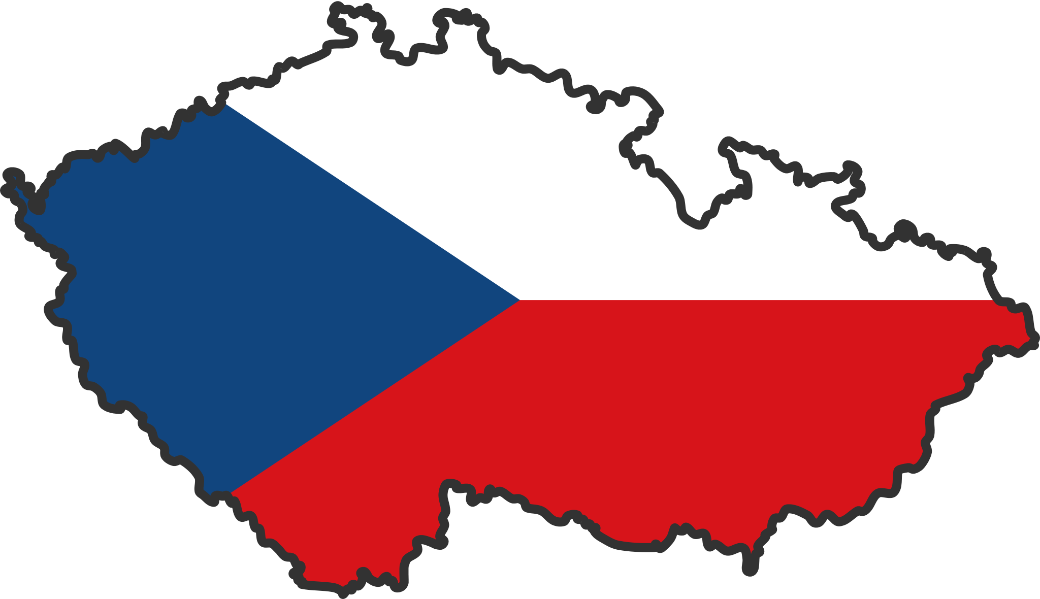
OUR TEAM Kateřina flussová Eliška němcová Pavel Maňák Lucie Matušková

Slide 2
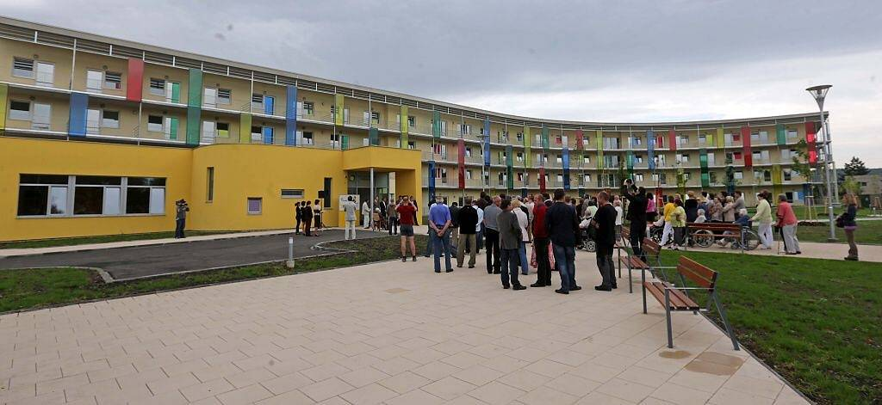
POHODA (retirement home)

Slide 3
Basic information
Renovated in June 2013
For seniors and for physically disabled people
Nice and modern
Capacity – 200 people
It offers lots of activities → → → → → →

Slide 4
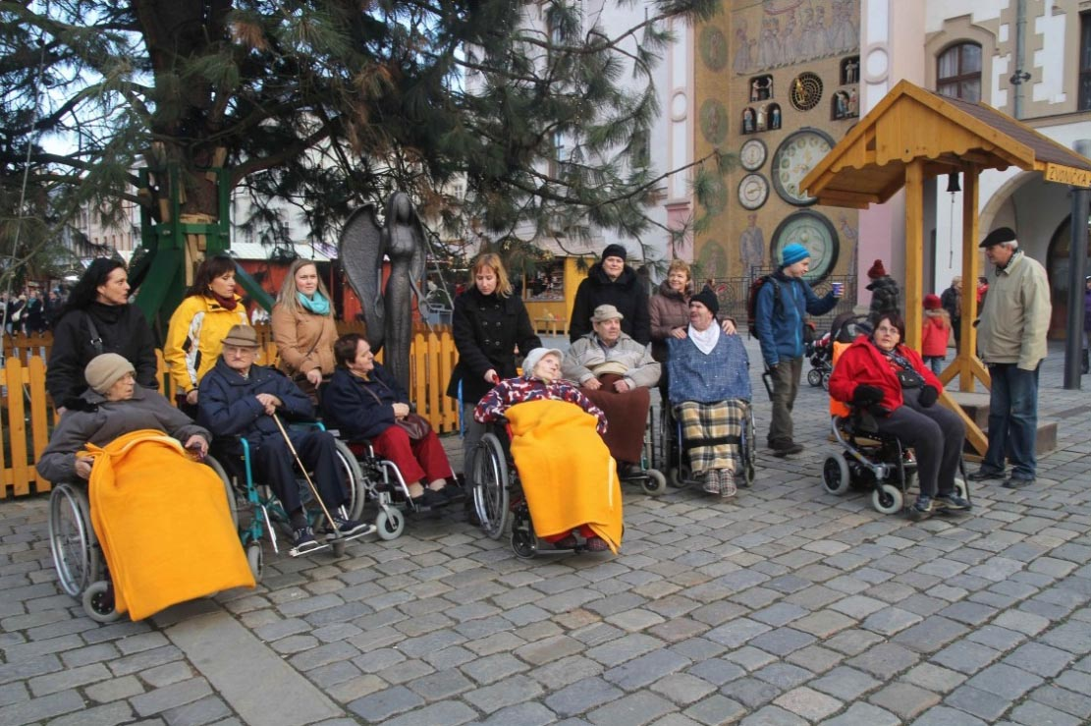
Trip to Olomouc

Slide 5
Playing petanque

Slide 6
Seniors performing for seniors

Slide 7
Christmas concert

Slide 8
Birthday celebration – 105 years

Slide 9
Dancing

Slide 10
Sports and games

Slide 11
The interview with a Physiotherapist
One physiotherapist takes care of 31 clients
Nearly everybody is involved in many kinds of activities
Activities for the clients:
individual exercises
group exercises
breathing exercises
memory training
The Olympics for seniors

Slide 12
The interview with a Physiotherapist
Most common disabilities:
Arthrosis
Gonarthrosis (in knee joints)
Rheumatism
Disabilities after a stroke

Slide 13
What did we do?
We interviewed 4 clients
Most of them were so excited to talk to us
We asked them some questions regarding their physical activities

Slide 14
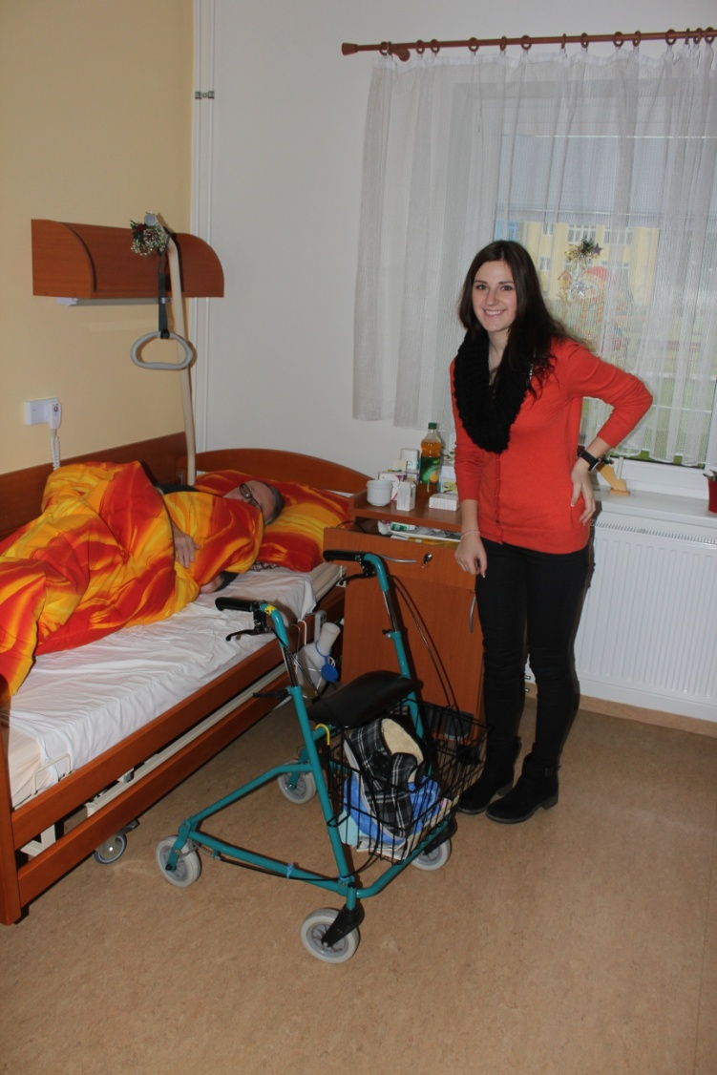
Pavel dosoudil
In the past: a teacher at a
secondary school
He used to play basketball, he used to run, cycle and ski
Trip to Sweden (running)
Lots of other acitivities
Fatal accident
Reitment home

Slide 15
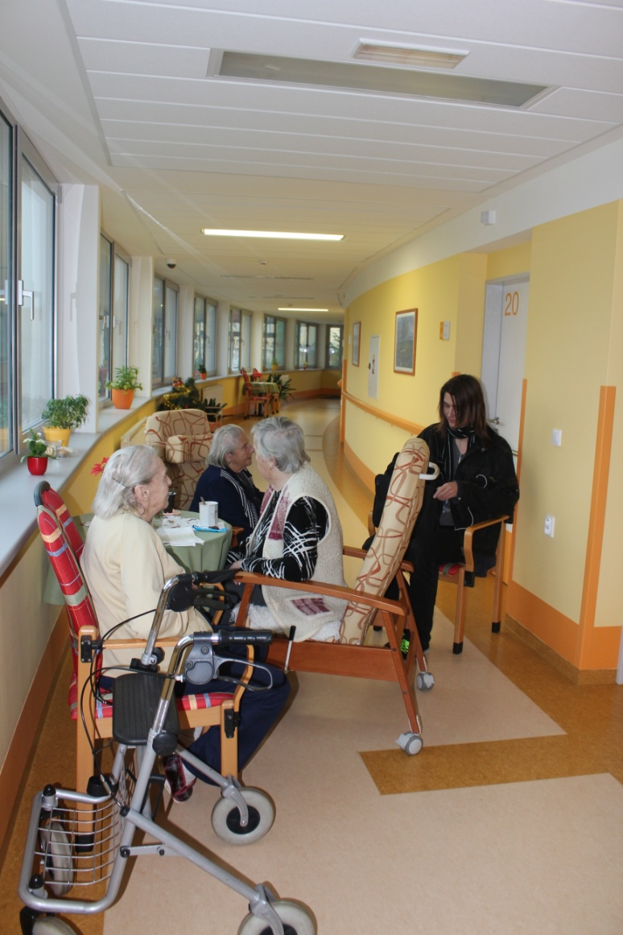
Hildegarda janoszik
93 years old (retired in 72)
In the past – Sokol (the first physical education organization)
Volleyball,football
Volunteer in a fire brigade and in a church
Spartakiáda (a big gymnastics event held every 5 years in the communist era)
http://www.youtube.com/watch?v=b84RmTTkc2M

Slide 16
Květoslava kolářová
85 years old
In the past – Sokol
Granddaughter – the winner of the Czech chamiponship in gymnastics
Nowadays - Nordic walking
Difficulties - she cannot make some movements

Slide 17
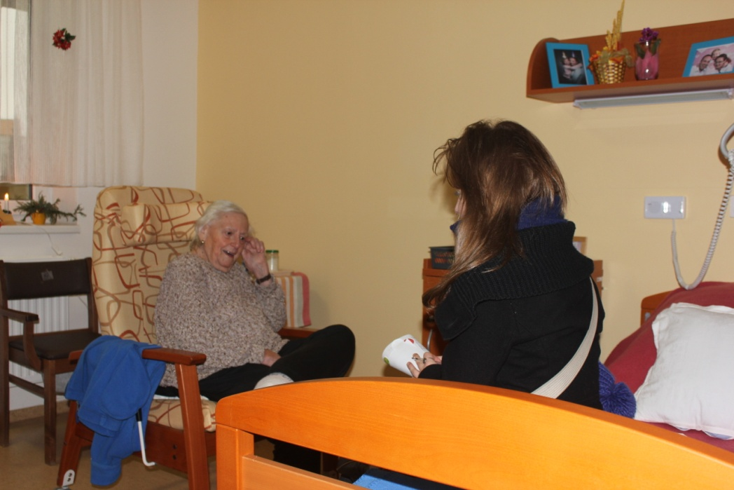
Milada vymazalová
85 years old
In the past – Sokol
her parents founded Sokol in her hometown
She used to go hiking and running
Her family plays football
Granddaughter – a tennis player in Germany
In these days her legs are paralysed

Slide 18
Most important sport event of their time
Emil Zátopek (a long-distance runner) who won 3 gold Olympic medals in Helsinky (1952) in the 5,000 meters and 10,000 metres runs, but his final medal came when he decided at the last minute to compete in the first marathon of his life.
He was nicknamed the Czech Locomotive
http://www.youtube.com/watch?v=RqozVyagbyc

Slide 19
Most popular sports in the czech republic
Ice hockey
During the World championship in ice hockey people watch hockey in pubs, they cheer a lot
Great success in the last 20 years
Gold medals – 2010, 2005, 2001, 2000, 1999, 1996
Olympics in Nagano – 1998: GOLD
http://www.youtube.com/watch?v=yMrTJqFfkcQ
Football – many Czech footballers play abroad
Floorball – a quite new sport, very popular
Tennis

Slide 20
AND what about OUR ATTITUDE TO SPORT???

Slide 21
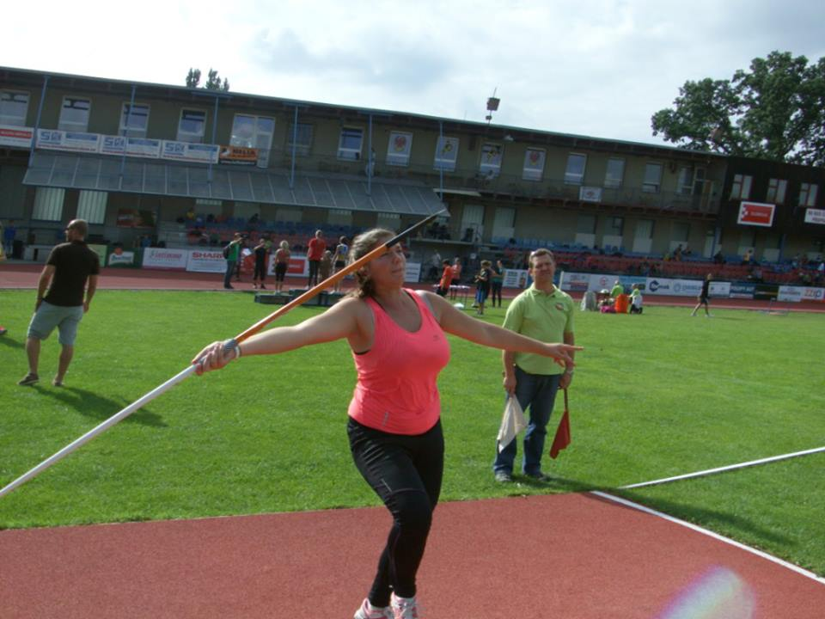

Slide 22
ELIŠKA NĚMCOVÁ
from 4 to 6: ice hockey
In these days - athletics competitively - javelin throw, dicsus throw,….
Roller skating
Swimming
Running

Slide 23
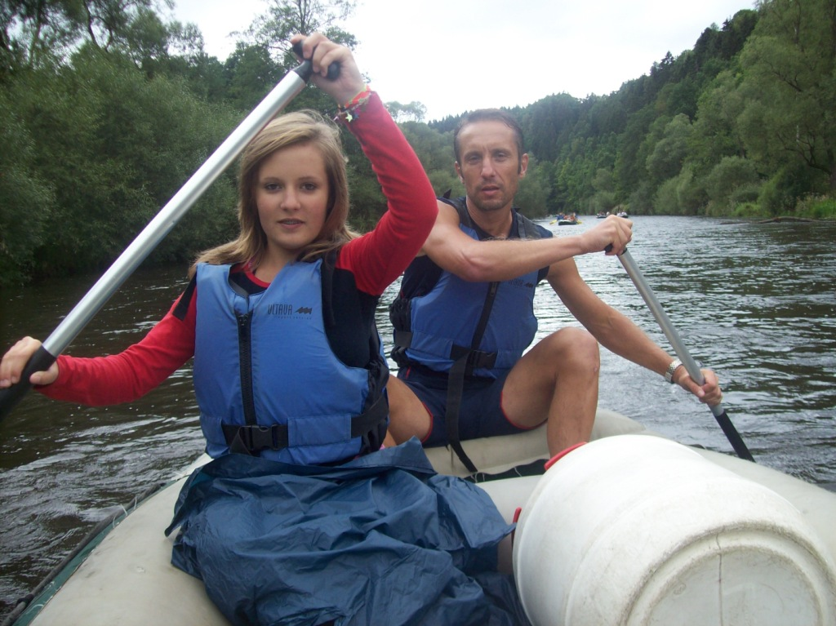

Slide 24
Kateřina flussová
Cycling
Nordic walking
Swimming
Skating
The only one winter sport I do is skiing

Slide 25
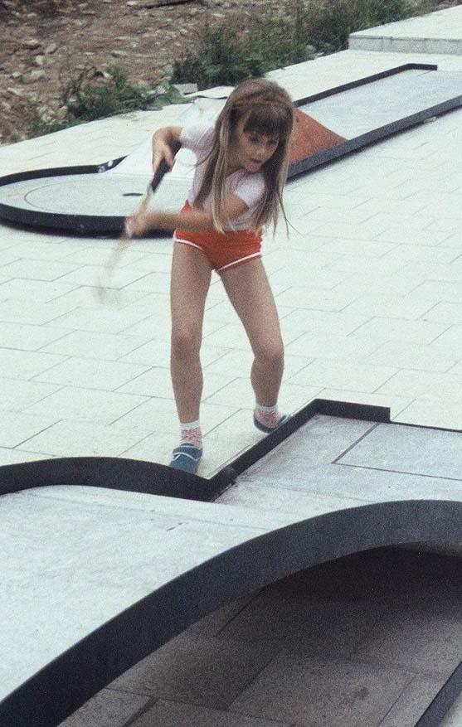
And what about our teachers?

